Slide 1
Anonimization Algorithm for Trade Transactions
Claudia Velázquez
November 2023

Slide 2
Agenda
Introduction
Trade information
Algorythm
Technology
Example

Slide 3

Introduction
Trade statistic is a National Interest Statistic in México
Many Projects include analysis of this data.
The group of institutions responsible of this statistic in Mexico, decide to publish the more granular data as possible without violating confidentiality.
Banco de Mexico created a algorithm to anonymize data allowing publication with the more detail possible.

Slide 4
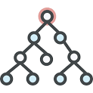
Trade information
The trade public information has the following variables:
Type of transactiion (import/export)
Month and year (since 1993)
Country (origin or destiny)
Products in Harmonized System (HS) of the World Trade Organization
USD amount
Volume
It has 13.5 million of transactions every month
The information is published in a tree structure where nodes can have a parent, grand parent, son, grandson, brothers, etc.

Slide 5
Algorithm
Objectives
The main objective of the algorithm is to provide the more granular data without violating confidentiality.
Avoid the possibility to identify the amount of the transaction of the firms.
Steps
The first step was removing companies name and tax ID.
Second step is to avoid that any company can infer the amount of their competitor.
The anonymization must include anonymize any combination of four variables: operation type, date, product and country (atomic combination).
If one atomic combination is anonymized , the algorithm has to ensure it cannot be inferred by subtraction.

Slide 6
Case 1 A product X exported to country A has two firms that have a export transaction in the month N, the USD amount and volumen of the product X to Country A in month N has to be anonimized
Rule 1. Atomic combinations
To show a atomic combination is necesary that this combination have at least three companies participating on it.
Atomic combination
Export
Product X
Country A
Month N
Firm 1
Firm 2
Case 2 A product Y exported to country B has three or more firms that have a export transaction in the month M, the USD amount and volumen of the product y to Country B in month M is not anonimized
Atomic combination
Export
Product Y
Country B
Month M
Firm 1
Firm 2
…
Firm N

Slide 7
Rule 2. Only child
If the atomyc combitanios doesn’t has brothers and it is anonimized, the father must be anonimized.
Case 1
No brothers
Case
Has brothers
Export
Product Y
Month M
Export
Product Y
Month M
Export
Product X
Country A
Month N
Export
Product Y
Country A
Month M
Export
Product Y
Country B
Month M
Export
Product Y
Country C
Month M

Slide 8
Rule 3. Solidary brother
If an atomic combination is anonimized and any of his brothers is anonimized, a solidary brother is needed.
The solidary brother is the “littlest” brother (in terms of value amount), and it is anonimized in order to avoid the possibitly to know the vlue of the anonimized brothed by subsctraction.
Father Group
Group 1
Group 2
Group 3
Group 4
Solidary brother

Slide 9
Rule 4. Solidary brother, son’s
If a solidary brother has two or less sons, the sons are anonimized also.
Grandfather Group
Group 1
Group 2
Group 3
Group 4
Solidary brother
Son 1
Son 2

Slide 10
Tree example
5 product levels (chapter, heading, sub-heading, code
2 country levels (región, country)

Slide 11


Technology
Recursive algorithm
Multidimensional data
Data is in a SQL data base
Algorithm is precharged
To optimize the quieries on web application
Developed in SQL
Querying Multidimensional Data with MDX
Analysis Services Cubes
Online execution

Slide 12
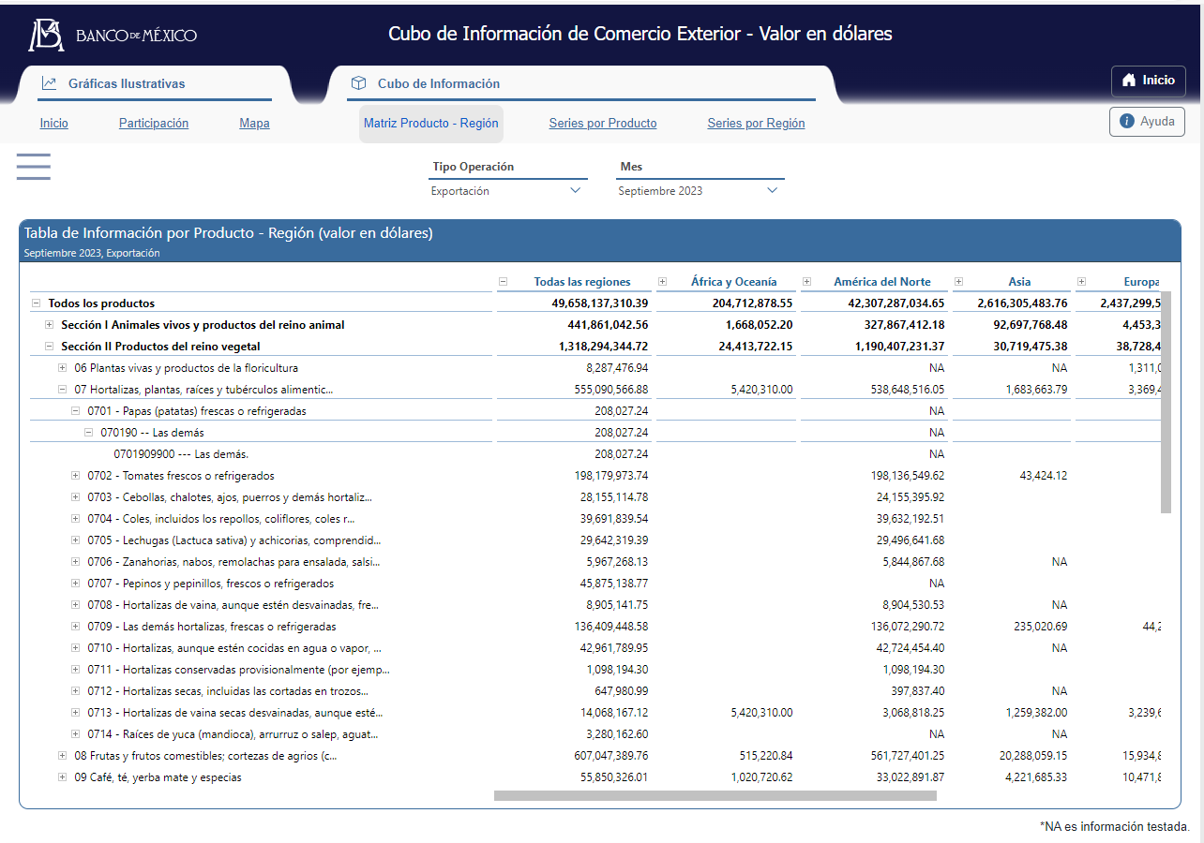
Example
https://www.banxico.org.mx/CuboComercioExterior/

Slide 13
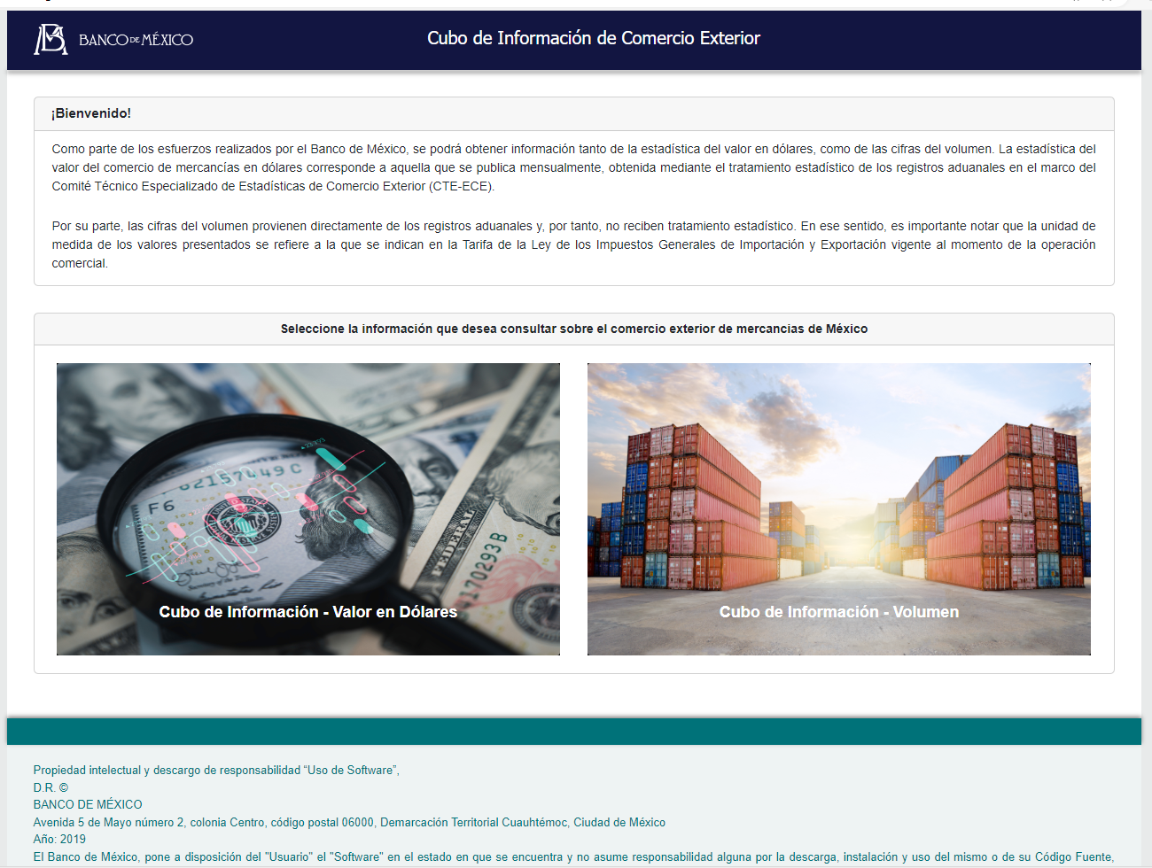
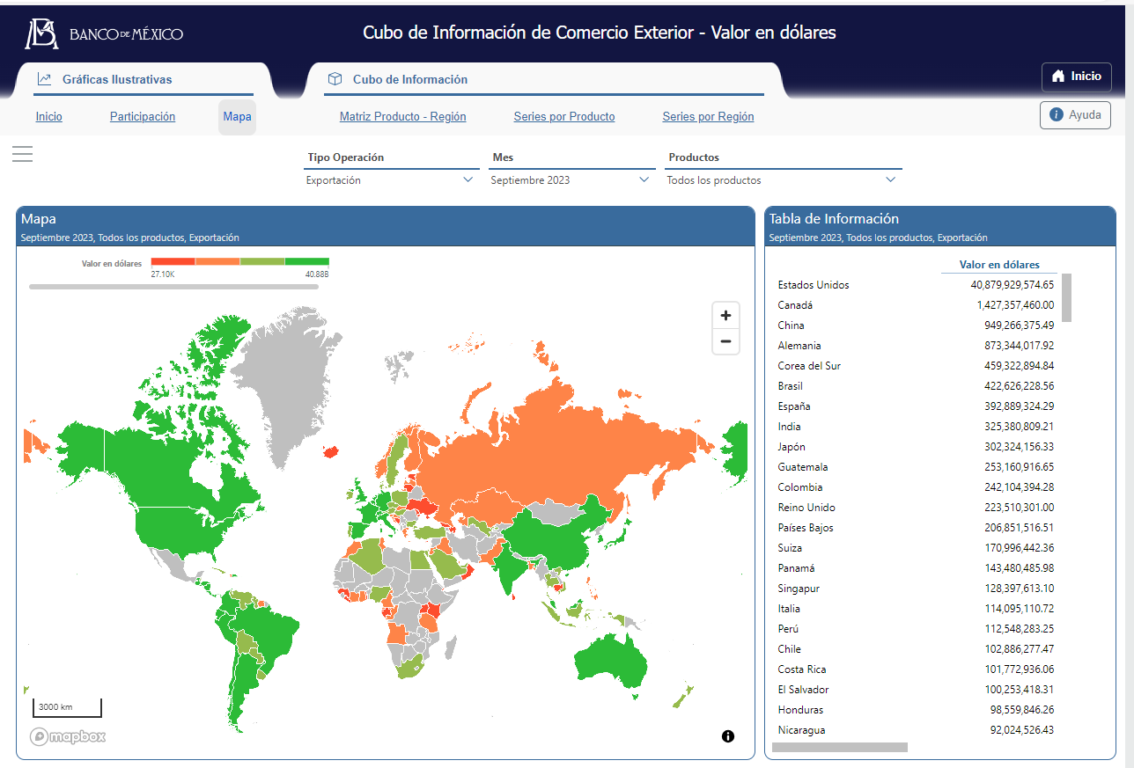
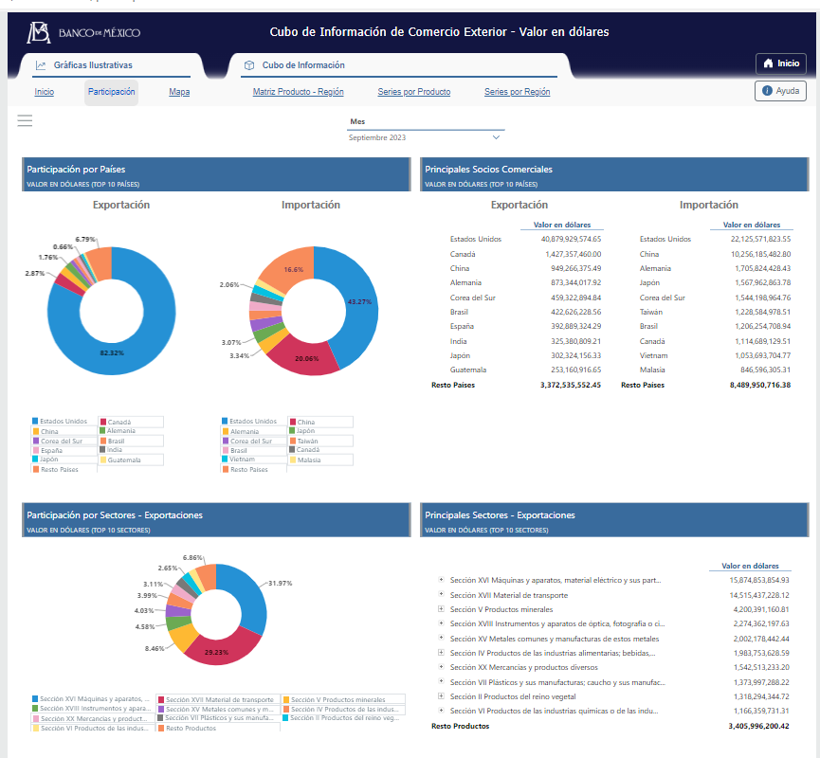
Results
This tool is published for the public
It allows different types of interactions with maps, graphs, or tables with the data.
It has aproximately 1,500 accesses per month.
In 2022 it wons a prize given by Transparency Mexican Institute
https://www.banxico.org.mx/CuboComercioExterior/

Slide 14

Questios

Slide 15
Thanks!

